Slide 1

FOOTBALL PLAYER MARKET VALUE PREDICTION
CAPSTONE PROJECT
Presented by Edú Muñoz

Slide 2
PROBLEM FRAMING
Contextual Significance
Football market values reflect player worth amid media growth, sponsorships, global appeal, and record-breaking transfers.
Project Goal
Predict 2022-2023 male football players' market value in top 5 leagues using Regression models, aiding data-driven recruitment and performance enhancement.
Motivation
Personal passion for football and data's pivotal role drive ML-powered decisions for clubs' success.
Research Focus
Analyze market value across player’s positions
Determine key player attributes impacting market value
Predict accurately player market value

Slide 3
DATA PROCESS
Data gathering
A systematic approach to retrieve and compile relevant data from Transfermarkt and FBRef sources using Python and R
Data cleaning
Involves identifying and rectifying errors, inconsistencies, and inaccuracies in the data
Exploratory data analysis
Entails visualizing and summarizing data to derive insights, patterns, and trends
Creates models that capture and understand complex relationships between variable to predictive the market value
Modelling

Slide 4


DATA SOURCES
TRANSFERMARKT
FBREF
Provides an extensive collection of historical and real-time data.
Their player market value estimations, derived from a combination of expert analysis and market trends, offer valuable insights into the dynamic nature of player valuations.
A reputable sports data provider, specializes in presenting comprehensive and detailed statistics for football matches, players, and teams.
The website's coverage spans various football leagues and competitions, ensuring access to diverse data points for in-depth analysis.

Slide 5





Data structure
Top 5 Europe Leagues
Leagues
5 Leagues
Germany
Teams
98 Teams
Spain
Players
3579 Players
England
Player’s Statistics
Types of statistics:
Standard
Shooting
Passing
Possession
Playing time
GCA
Italy
France

Slide 6

DATA GATHERING WORKFLOW
Retrieve football clubs
Retrieve player’s name and market value
Get player main facts
Get player season statistics
Aggregate player season statistics
Generate raw dataset
Python – BeautifulSoup library
R – worldFootballR package
Python
What is Web Scraping?
Web scraping with BeautifulSoup: Python code parses HTML, extracts data from websites, automates data collection for business insights.
Raw dataset shape:
3555 rows
113 columns

Slide 7
Data cleaning
Remove Rows and Columns
Handle Missing Values
Columns with incomplete information such as: players who doesn’t have statistics or minutes played during the season
Identifiers columns
The Project is not considering goalkeeper market value prediction.
19 columns with missing values.
Types of imputation used: Median Imputation, Mode Imputation, Constant Imputation
Example:
Outfitter
adidas
NaN
Outfitter
True
False

Slide 8
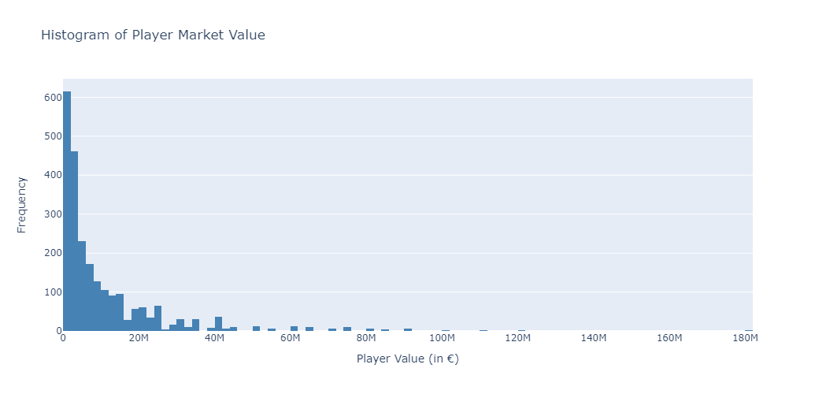
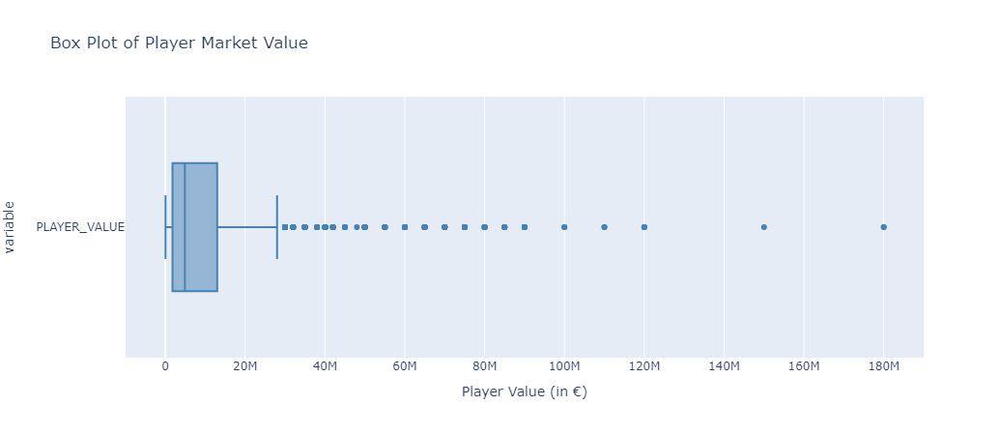
Exploratory Data Analysis
Output variable Analysis
90% of players has a MARKET VALUE less than €25,000,000

Slide 9
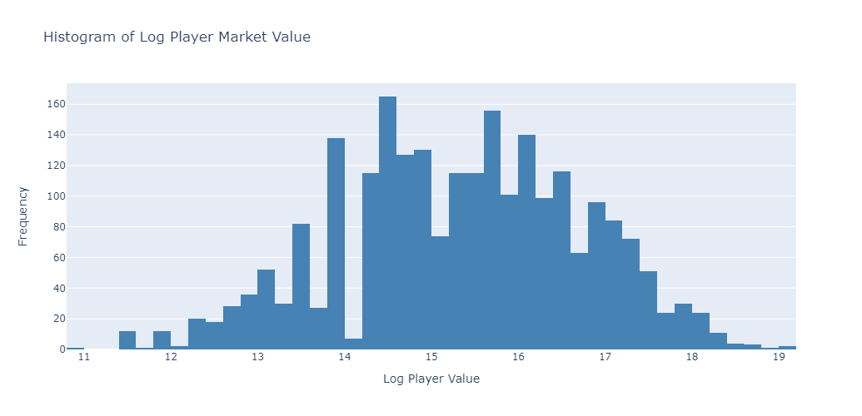
Exploratory Data Analysis
Output variable after Log Transformation

Slide 10
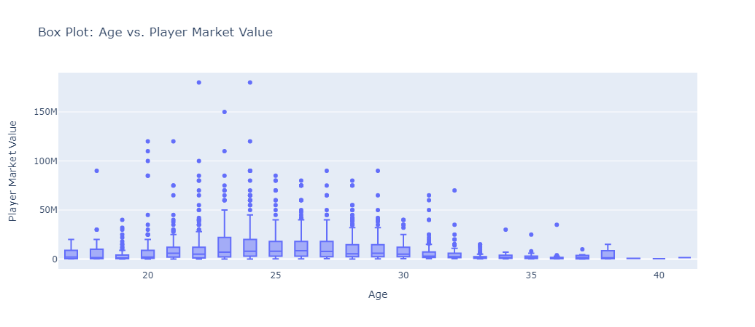
Exploratory Data Analysis
Features Analysis Insights

Slide 11
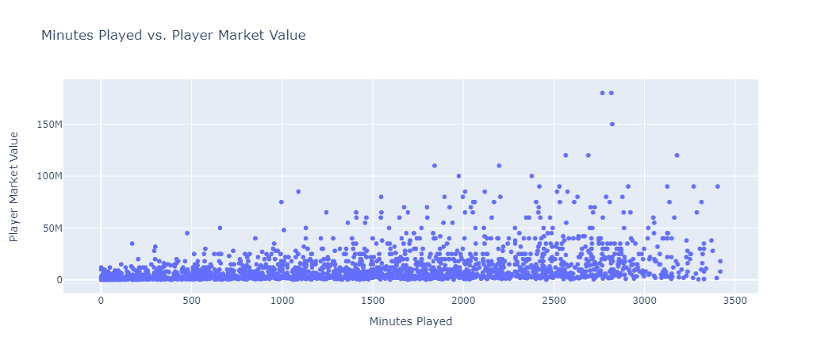
Exploratory Data Analysis
Features Analysis Insights

Slide 12
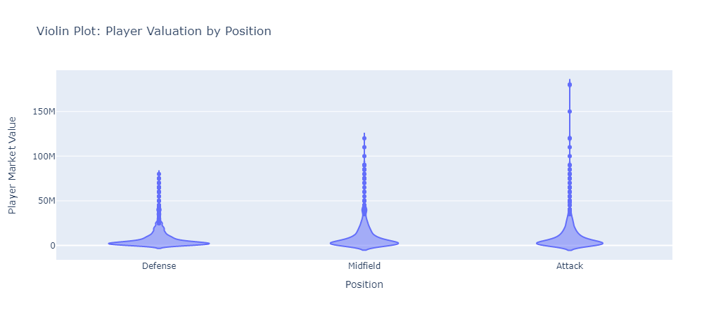
Exploratory Data Analysis
Features Analysis Insights

Slide 13
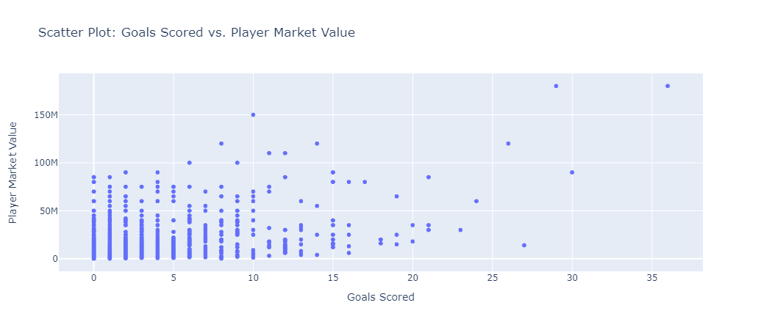
Exploratory Data Analysis
Features Analysis Insights

Slide 14
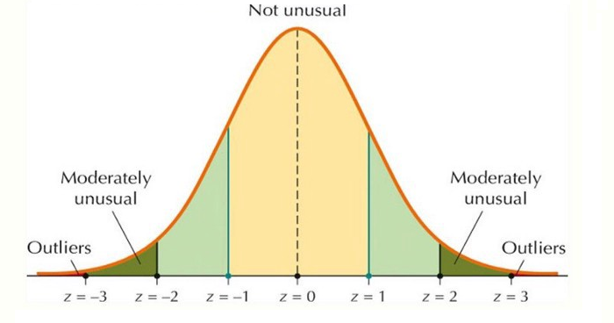
Data preprocessing
Drop Correlated Variables
Handle Outliers
Variables were clustered using Kmeans, then heatmaps were plotted to identify correlated pairs
Correlated variables were identified to be dropped:
Some of them: Goals Scored, Shots, Balls Recovered, etc
Used the Z-score method to identify and replace outliers in numerical columns of the dataframe, ensuring data integrity and reliability.
45 correlated variables

Slide 15
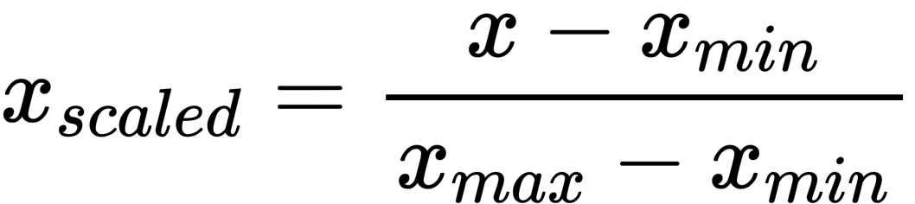
Data PREPROCESSING
Create Dummies
Apply Normalization
Prepared categorical data for machine learning: Label encoded specified columns, converting them into numerical values, and one-hot encoded the rest of categorical variables to transform data into a suitable format for analysis.
Standardized numerical data using Min-Max Scaling, ensuring values are between 0 and 1.
It enhances model performance by normalizing feature scales for accurate analysis and prediction.
Example:
foot
right
left
both
f_right | f_left | f_both
1 | 0 | 0
0 | 1 | 0
0 | 0 | 1

Slide 16
Models Created Using Train-Test Split Technique
Test size = 0.4
Linear Regression
Decision Tree
Lasso Regression
Decision Tree Regression
R² = 0.64
R² = 0.42
R² = 0.00
R² = 0.42
RMSE = 0.83
RMSE = 1.05
RMSE = 1.37
RMSE = 1.05

Slide 17
Models Created Using k-fold Technique
Test size = 0.4
K-folds = 5
Linear Regression
Decision Tree
Lasso Regression
Decision Tree Regression
R² = 0.65
R² = 0.78
R² = 0.00
R² = 0.78
RMSE = 0.84
RMSE = 1.04
RMSE = 1.40
RMSE = 1.04

Slide 18
Model optimization using hyperparameter tuning
Test size = 0.4
K-folds = 5
Gradient Boosting Regression
Decision Tree Regression
R² = 0.78
R² = 0.56
RMSE = 0.65
RMSE = 0.91

Slide 19
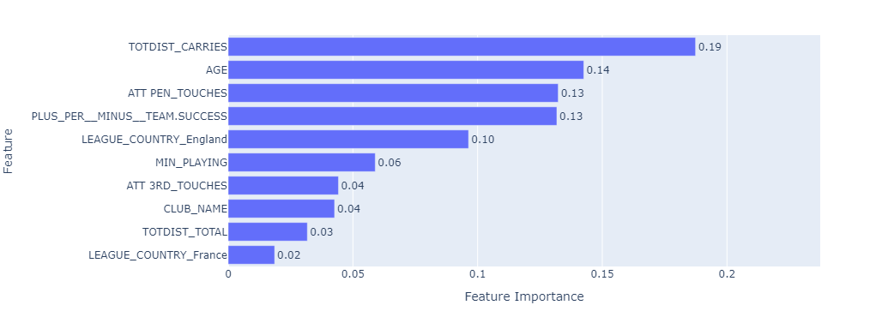
Top 10 most important features
 | RMSE | R2
Train | 0.37 | 0.93
Test | 0.65 | 0.78
Optimized Gradient Boosting Regression Model
View important features of second-best model

Slide 20
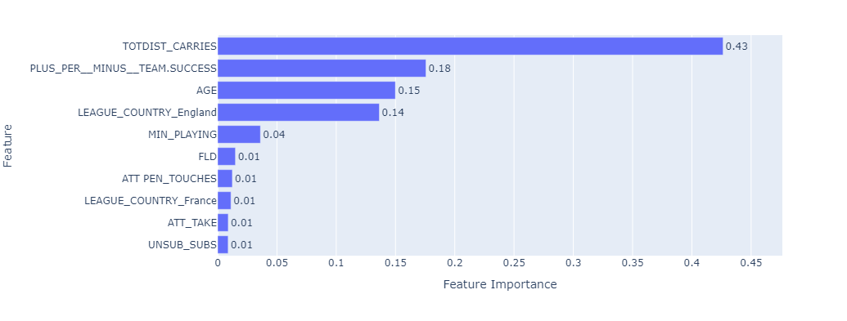
Top 10 most important features
 | RMSE | R2
Train | 0.79 | 0.69
Test | 0.91 | 0.56
Optimized Decision Tree Regression Model

Slide 21
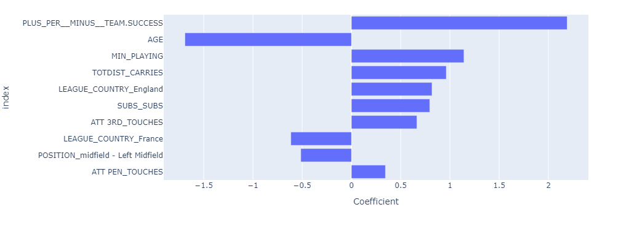
Top 10 most important features
 | RMSE | R2
Train | 0.83 | 0.66
Test | 0.83 | 0.64
Ridge Regressor Model

Slide 22
conclusions
Player’s Position Valuation Difference
Key Factors Driving Player Valuation
High-Performance Gradient Boosting Model
Attacking players exhibit higher market values compared to defensive counterparts.
The analysis reveals that specific player attributes significantly influence market value prediction such as:
Age
Goal difference while on the pitch
Touches in attacking penalty area
Total distance covered
Minutes Played
The best-performing model demonstrates its prowess with an impressive root mean squared error (RMSE) of 0.65 and an R-squared (R²) value of 0.78.
This indicates the model's strong predictive ability and close fit to the actual player market values.

Slide 23
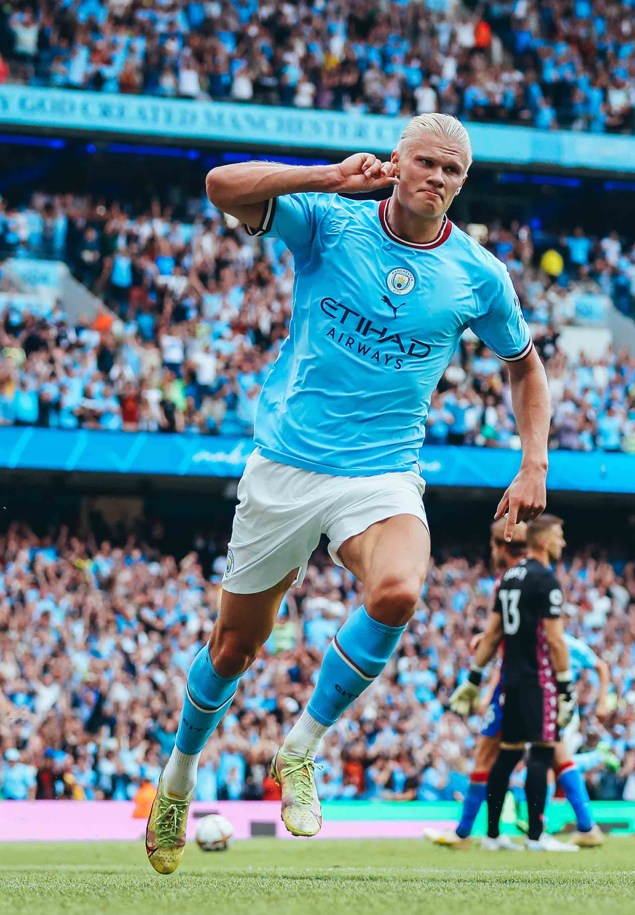
Recommendations
Retrieve promising players (age 14-18) statistics to predict their market value
Test the model with players from other leagues to avoid overfitting.
Include social media variables (media coverage, social media presence)
Consider current contract type
Consider player’s transfer history
Consider player’s injury history

Slide 24
THANK YOU
Questions?
Notes:
Is it possible to create submodels based on the players position?
Yes, based on the violin graph showed before there is a valuation difference between positions so, it would be interesting to explore if there are difference in the most important features across the different positions
Have you analyzed if there is an over fitting in your model? Considering the complexity of your data.
Yes, there is a slight overfitting in the best model, the gradient boosting regressor. One of the recommendations I would suggest is try PCA, to explain the variance in fewer variables. Even dropping the correlated variables, the model is quite complex.
Have you thought about any other machine learning algorithms that can help you predict your output variable?
Yes, there is one I was exploring that is the Ridge Regressor. This method performs a L2 regularization, it is useful when there is multicollinearity. In simple terms, this algorithm penalizes the model score for making it too complex. It encourages the model not to rely in a single feature. It is a great technique to find a balance between fitting the data and staying simple.

